Slide 1
🐼
Data Cleaning
with Pandas
Complete Teaching Deck - All Techniques with Code and Line-by-Line Explanations
Platform: Google Colab | Library: pandas (import pandas as pd)
Inspect
Missing Values
Duplicates
Data Types
KAJOLA GBENGA ADEWALE
String Cleaning
Outliers
Rename / Reorder
Filtering
Data Analytics Expert
groupby
merge / join
apply / map
Validation
Notes:
This deck covers every major pandas data cleaning technique with real code examples and line-by-line explanation tables for every code block. All code runs in Google Colab. Platform: import pandas as pd. The deck follows the standard 10-step cleaning pipeline used in professional data engineering.

Slide 2
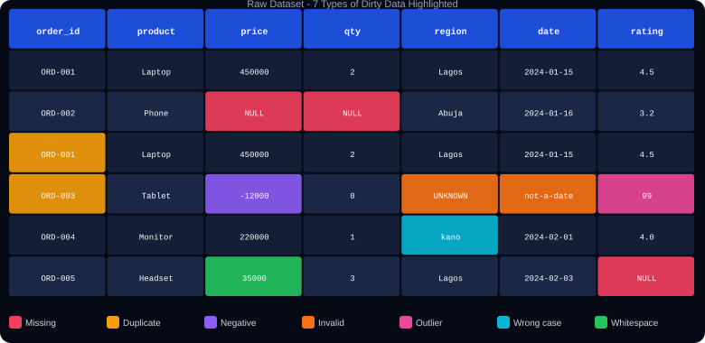
WHY DATA CLEANING MATTERS - The Real Cost of Dirty Data
Rule: Never visualise or model dirty data. Every chart and every ML model trained on dirty data is wrong. Clean first - always.
Notes:
The dirty data table highlights 7 different data quality issues in a single dataset: missing values (NULL), negative prices, zero quantities, wrong categories (UNKNOWN), wrong case (kano vs Lagos), whitespace in values, and outliers (rating=99). All highlighted in different colours. Ask students to count how many issues they can spot.

Slide 3
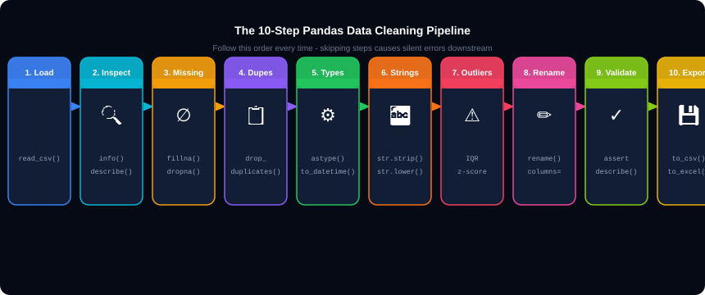
THE 10-STEP PANDAS CLEANING PIPELINE
💡 Always in order
💡 Save checkpoints
💡 Never modify raw
Steps 1-10 are not arbitrary. Missing values must be handled before type conversion. Duplicates must be removed before statistics.
After each major step, print df.shape and df.isnull().sum() to confirm progress.
Always work on a copy: df_clean = df.copy(). Keep the original untouched.
Notes:
The 10-step pipeline. Emphasise: this is the professional workflow. Skipping step 3 (missing values) and going straight to step 5 (types) often fails silently because NaN values prevent astype() from working. The df.copy() at step 1 is critical - never modify the DataFrame loaded directly from the CSV.

Slide 4
01
Load and First Look
Know your data before you touch it.

Slide 5
LOADING DATA AND INITIAL INSPECTION
load_inspect.py
Line of Code
What It Does
import pandas as pd
import numpy as np
# Load the dataset
df = pd.read_csv('data.csv')
df_clean = df.copy() # always work on a copy
# Shape and columns
print(df.shape) # (rows, cols)
print(df.columns.tolist())
print(df.dtypes)
# First and last rows
df.head() # first 5 rows
df.tail() # last 5 rows
df.sample(5) # random 5 rows
# Statistics
df.info() # dtypes + nulls
df.describe() # numeric stats
df.describe(include='object') # string cols
# Missing values
df.isnull().sum() # count per col
df.isnull().sum() / len(df) * 100 # pct missing
df.duplicated().sum() # duplicate rows
import pandas as pd
Imports the Pandas library. pd is the universal alias used by all data professionals.
import numpy as np
Imports NumPy, needed for np.nan and numeric operations used during cleaning.
pd.read_csv('data.csv')
Reads the CSV file from disk and loads it into a DataFrame - a 2D table with rows and columns.
df.copy()
Creates an independent copy. Changes to df_clean will NOT affect the original df. Always do this.
df.shape
Returns (number_of_rows, number_of_columns). First thing to check after loading.
df.dtypes
Shows the data type of each column: int64, float64, object (text), datetime64. Reveals type problems.
df.info()
Prints column names, dtype, and count of non-null values per column. Shows missing values at a glance.
df.describe()
Returns count, mean, std, min, quartiles, max for every numeric column. Spot outliers here.
df.isnull().sum()
Counts missing values per column. isnull() returns True/False, sum() counts the Trues.
df.duplicated().sum()
Counts rows that are exact duplicates of another row. Returns integer count.
Notes:
The first 10 minutes of any data project. Students should run every one of these commands before doing anything else. df.describe() often reveals outliers immediately - a minimum price of -45000 or maximum age of 999 are instant red flags.

Slide 6
02
Missing Values
The most common data quality problem in every real dataset.

Slide 7
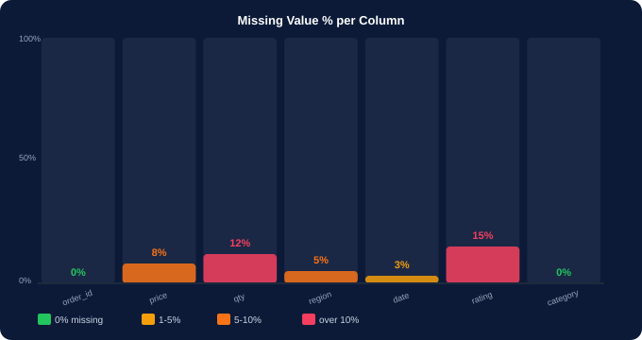
DETECTING MISSING VALUES
detect_missing.py
# Null count per column
df.isnull().sum()
# Percentage missing
null_pct = (df.isnull().sum()
/ len(df) * 100).round(2)
print(null_pct[null_pct &gt; 0])
# Which rows have any null?
df[df.isnull().any(axis=1)]
# Visual missing map
import missingno as msno
msno.matrix(df)
msno.bar(df)
Code
What It Does
df.isnull()
Returns a DataFrame of True/False. True = the cell is missing.
.sum()
Counts True values per column - giving missing count per column.
/ len(df) * 100
Converts count to percentage. Divide by total rows, multiply by 100.
null_pct &gt; 0
Boolean filter - only show columns that actually have missing values.
axis=1
axis=1 means across columns (row-by-row). axis=0 means across rows (column-by-column).
Notes:
Missing value detection. The msno library (pip install missingno) creates a visual matrix where white lines = missing. For columns missing over 50% of data, consider dropping the column entirely rather than filling. Under 5% missing is generally acceptable to fill or drop.

Slide 8
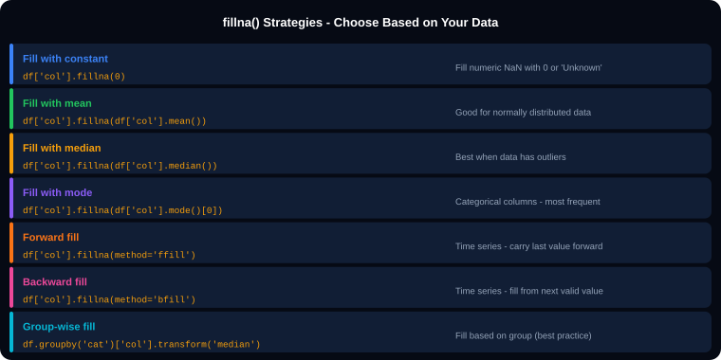
FILLING MISSING VALUES - fillna() Strategies
fillna.py
# 1. Fill with constant
df['price'].fillna(0, inplace=True)
df['region'].fillna('Unknown', inplace=True)
# 2. Fill with mean/median
mean_p = df['price'].mean()
df['price'].fillna(mean_p, inplace=True)
# Use median for skewed data
med_p = df['price'].median()
df['price'].fillna(med_p, inplace=True)
# 3. Fill with mode (categories)
mode_r = df['region'].mode()[0]
df['region'].fillna(mode_r, inplace=True)
# 4. Forward/backward fill
df['price'].fillna(method='ffill', inplace=True)
df['price'].fillna(method='bfill', inplace=True)
# 5. Group-wise fill (best practice)
df['price'] = df.groupby('category')['price']
.transform(lambda x: x.fillna(x.median()))
Notes:
fillna() strategies. The group-wise median fill is the most professional approach. Instead of filling all missing prices with the global median, it fills each row with the median price for that row's category - much more accurate. inplace=True modifies the DataFrame directly instead of returning a new one.

Slide 9
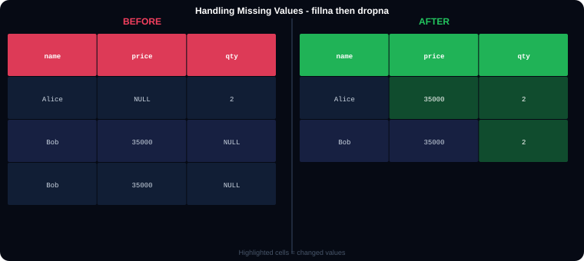
fillna() - Line-by-Line Explanation
Code
What It Does
df.dropna()
Drops ALL rows that have at least one NaN value. Use carefully - can remove too many rows.
df.dropna(subset=['price'])
Drops only rows where the 'price' column is NaN. Other nulls are kept.
df.dropna(thresh=5)
Keeps rows with at least 5 non-null values. thresh=minimum number of valid values required.
df.dropna(axis=1)
Drops entire COLUMNS that contain any NaN. axis=1 means along columns.
df.dropna(how='all')
Drops rows only if ALL values in the row are NaN. how='any' (default) drops if any are NaN.
df.isnull().sum()
Run this after fillna/dropna to verify no missing values remain.
Code
Explanation
df['price'].fillna(0)
Fills every NaN in the price column with 0. Returns new Series - use inplace=True to modify df directly.
inplace=True
Modifies the DataFrame in place without needing reassignment. Equivalent to: df['col'] = df['col'].fillna(value).
df.notnull()
Returns True where the value IS present. Opposite of isnull().
.mean() .median()
Compute the average / middle value of the column, ignoring NaN. Use as fill value.
.mode()[0]
.mode() returns a Series of most frequent values. [0] picks the first (most common) one.
method='ffill'
Forward fill: propagates the LAST valid value downward. Useful for time series.
method='bfill'
Backward fill: propagates the NEXT valid value upward. Also useful for time series.
.groupby('category')
Groups rows by the category column before computing the fill value. Each group gets its own median.
.transform(lambda x: ...)
Applies a function per group and returns a Series aligned to the original index for direct assignment.
Notes:
dropna() vs fillna(). Rule: fillna() for columns where you have a reasonable imputation strategy. dropna() for rows where the key columns are missing and the row is unusable. Always check df.shape before and after to know how many rows you removed.

Slide 10
03
Duplicate Rows
Silent killers of aggregation and count analysis.

Slide 11

FINDING AND REMOVING DUPLICATE ROWS
Line of Code
What It Does
df.duplicated()
Returns a Boolean Series: True = this row is a duplicate of a previous row. False = unique row.
.sum()
Counts the True values - giving the total number of duplicate rows found.
keep=False
Marks ALL copies of a duplicate row as True (default keep='first' only marks the 2nd+ occurrences).
drop_duplicates()
Removes all duplicate rows, keeping the first occurrence by default.
keep='last'
Optional: keep='last' keeps the last occurrence instead of the first.
duplicates.py
subset=['col1','col2']
Check duplicates only on specific columns. Example: drop_duplicates(subset=['order_id']).
# How many duplicate rows?
df.duplicated().sum()
# View the duplicate rows
df[df.duplicated()]
df[df.duplicated(keep=False)] # see ALL copies
# Remove duplicates
df = df.drop_duplicates()
df.reset_index(drop=True, inplace=True)
reset_index(drop=True)
Resets the row index to 0,1,2,3... after removing rows. drop=True discards the old index.
df.shape before/after
Always compare shape before and after: print(f'Removed: {before-after} rows').
Notes:
Duplicates. The subset= parameter is critical in practice. A full row duplicate (all columns identical) is rare. More common: duplicate order_id with slightly different data (data entry error). In that case: drop_duplicates(subset=['order_id'], keep='first') removes based on just the ID column.

Slide 12
04
Data Type Conversion
Wrong types cause silent calculation errors.

Slide 13
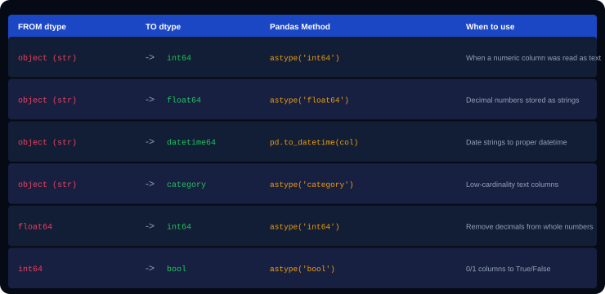
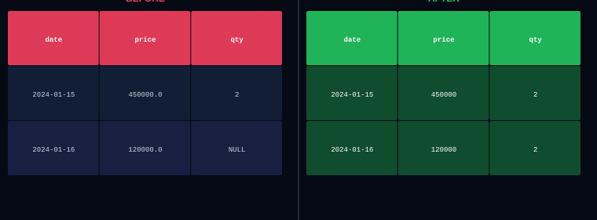
FIXING DATA TYPES - astype() and to_datetime()
Line of Code
What It Does
df.dtypes
Shows the current data type of every column. object = string/mixed. Spot type problems here.
df['col'].astype('int64')
Converts the column to integer. Fails if the column has non-numeric values or NaN.
df['col'].astype('float64')
Converts to decimal number. More forgiving than int64 with NaN.
df['col'].astype('str')
Converts to string. Any value becomes text including numbers.
df['col'].astype('category')
Converts low-cardinality text to category type. Uses less memory. Good for region, gender, etc.
pd.to_numeric(col, errors='coerce')
Converts to number. errors='coerce' turns unparseable values into NaN instead of crashing.
types.py
pd.to_datetime(col)
Converts a date string column to datetime64 type. Enables .dt.year, .dt.month, etc.
# Safe type conversion with error handling
df['price'] = pd.to_numeric(df['price'],
errors='coerce')
df['date'] = pd.to_datetime(df['date'],
errors='coerce')
df['month'] = df['date'].dt.month
df['year'] = df['date'].dt.year
df['date'].dt.year
Extracts the year from a datetime column. Also: .dt.month .dt.day .dt.day_name()
errors='coerce'
Key parameter for safe conversion. Instead of raising an error on bad values, it returns NaN.
Notes:
Data types. The most important: date columns loaded from CSV always come in as object (string). pd.to_datetime() converts them to datetime64, which unlocks all .dt accessor methods for time-based analysis. pd.to_numeric with errors='coerce' is safer than astype because it handles bad values gracefully.

Slide 14
05
String Cleaning
Whitespace, wrong case, and embedded characters ruin groupby.

Slide 15
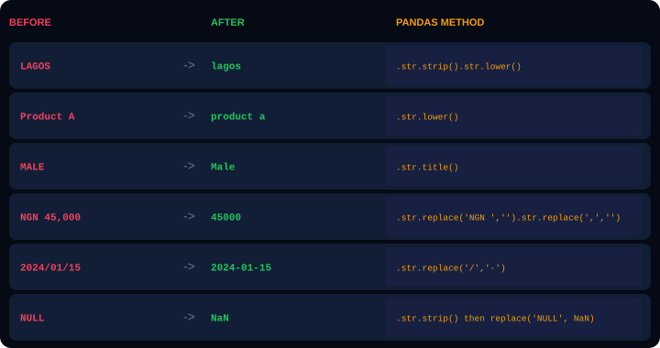
CLEANING TEXT COLUMNS - The .str Accessor
Method
What It Does
.str.strip()
Removes leading and trailing whitespace. ' Lagos ' becomes 'Lagos'.
.str.lower()
Converts all characters to lowercase. 'LAGOS' becomes 'lagos'.
.str.upper()
Converts all characters to uppercase. 'lagos' becomes 'LAGOS'.
.str.title()
Title Case - first letter of each word capitalised. 'lagos state' becomes 'Lagos State'.
.str.replace('a','b')
Replaces substring 'a' with 'b'. Use regex=True for pattern matching.
.str.contains('text')
Returns True/False if the string contains 'text'. Used for filtering.
.str.startswith('ORD-')
Returns True if string starts with 'ORD-'. Used to validate ID formats.
str_clean.py
.str.split(',', expand=True)
Splits on comma and expands into separate columns. expand=True returns a DataFrame.
# Real cleaning example
df['region'] = df['region'].str.strip().str.title()
df['category'] = df['category'].str.strip().str.title()
df['price'] = (df['price']
.str.replace('NGN','',regex=False)
.str.replace(',','',regex=False)
.str.strip()
.astype('float64'))
.str.len()
Returns the length of each string. Useful for validating phone numbers, IDs.
str_chain.py
# Chain multiple operations
df['region'] = df['region'].str.strip().str.title()
.str.zfill(5)
Pads with leading zeros to reach length 5. '42' becomes '00042'. For invoice IDs.
Notes:
String cleaning is the most commonly needed cleaning step. The .str accessor applies string methods to every row in a column. Always chain .str.strip() before .str.lower() or .str.title() to remove spaces first. The price cleaning example (removing NGN and commas before astype) is a very common real-world pattern.

Slide 16
06
Rename and Reorder Columns
Clean column names make every downstream operation easier.

Slide 17
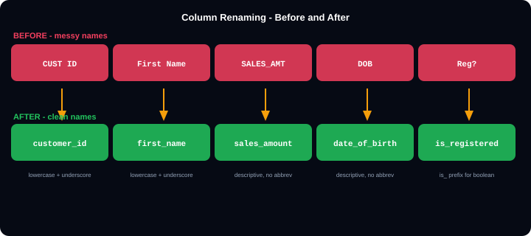
RENAMING, REORDERING, AND SELECTING COLUMNS
Line of Code
What It Does
df.rename(columns={...})
Renames specific columns using a dictionary {old_name: new_name}. Does not change other columns.
inplace=True
Applies the rename directly to df. Without it, rename() returns a new DataFrame.
df.columns = ['a','b','c']
Replaces ALL column names at once. The list must match the exact number of columns.
df.columns.str.lower()
Converts all column names to lowercase in one command.
df.columns.str.replace(' ','_')
Replaces spaces with underscores in all column names at once.
rename.py
df[['col1','col2','col3']]
Selects and reorders columns. Double brackets return a DataFrame.
rename2.py
# Rename specific columns
df.rename(columns={
'CUST ID': 'customer_id',
'First Name': 'first_name',
'SALES_AMT': 'sales_amount',
'DOB': 'date_of_birth',
'Reg?': 'is_registered',
}, inplace=True)
# Bulk rename: all lowercase + underscores
df.columns = (df.columns
.str.lower()
.str.strip()
.str.replace(' ','_',regex=False))
# Select and reorder columns
cols = ['customer_id','date','product','sales_amount']
df = df[cols]
df.drop('col', axis=1)
Drops a column. axis=1 means along columns (axis=0 would drop a row).
df.drop(['c1','c2'], axis=1)
Drops multiple columns at once by passing a list.
Notes:
Column naming conventions. Always use snake_case (lowercase with underscores) for column names. It avoids needing df['First Name'] (spaces require bracket notation) and makes column access with dot notation possible: df.first_name. The bulk rename pipeline is the fastest way to clean all column names at once.

Slide 18
07
Filtering and Removing Invalid Rows
Remove the rows that should never have existed.

Slide 19
FILTERING ROWS - Remove Invalid, Negative, and Out-of-Range Data
filtering.py
Line of Code
What It Does
# Remove rows with negative prices
df = df[df['price'] &gt; 0]
# Remove zero-quantity rows
df = df[df['quantity'] &gt; 0]
# Keep only valid regions
valid_regions = ['Lagos','Abuja','Kano','Port Harcourt']
df = df[df['region'].isin(valid_regions)]
# Remove 'UNKNOWN' category
df = df[df['region'] != 'UNKNOWN']
# Keep rows within a date range
df = df[df['date'] &gt;= '2024-01-01']
df = df[(df['date'] &gt;= '2024-01-01') and
(df['date'] &lt;= '2024-12-31')]
# Compound condition (multiple rules)
mask = (
(df['price'] &gt; 0) and
(df['quantity'] &gt; 0) and
(df['region'].isin(valid_regions))
)
df = df[mask]
# Rating between 1 and 5 only
df = df[df['rating'].between(1, 5)]
df[df['price'] &gt; 0]
Boolean indexing. df['price'] &gt; 0 returns True/False per row. Passing that back into df[] keeps only True rows.
df['col'].isin(list)
Returns True for rows where the column value is in the provided list. Best way to filter to known valid values.
df['col'] != 'UNKNOWN'
Keeps rows where region is NOT 'UNKNOWN'. != is the not-equal operator.
df['date'] &gt;= '2024-01-01'
Works when the date column is datetime type. Compares dates chronologically.
(cond1) and (cond2)
Combine conditions. Use and (and) and | (or) for DataFrame filtering, NOT Python's and/or keywords.
df['col'].between(1, 5)
Returns True where value is between 1 and 5 inclusive. Cleaner than writing col &gt;= 1 and col &lt;= 5.
mask variable
Store compound conditions in a variable called mask for readability. Then apply: df = df[mask].
df.shape before/after
Always print shape before and after filtering to confirm how many rows were removed.
Notes:
Filtering. The single most important syntax rule: use & (ampersand) for AND and | (pipe) for OR in pandas boolean operations. Python's 'and' and 'or' keywords do NOT work with Series. Also: always wrap each condition in parentheses when combining: (df['a'] > 0) & (df['b'] > 0).

Slide 20
08
Outlier Detection and Handling
Extreme values that distort averages, charts, and models.

Slide 21
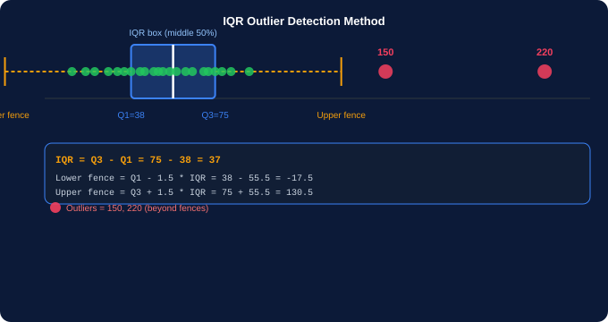
DETECTING AND HANDLING OUTLIERS
Line of Code
What It Does
df['col'].quantile(0.25)
Returns Q1 - the value at the 25th percentile. 25% of values fall below this point.
df['col'].quantile(0.75)
Returns Q3 - the value at the 75th percentile. 75% of values fall below this point.
IQR = Q3 - Q1
Interquartile Range. The spread of the middle 50% of data.
Q1 - 1.5 * IQR
Lower fence. Values below this are considered outliers (the Tukey rule).
Q3 + 1.5 * IQR
Upper fence. Values above this are considered outliers.
Z-score method
from scipy import stats
z = np.abs(stats.zscore(df['price']))
df = df[z &lt; 3]
Capping (winsorize)
df['price'].clip(lower=Q1-1.5*IQR, upper=Q3+1.5*IQR)
Caps values instead of removing rows.
outliers.py
iqr.py
# Z-score method
from scipy import stats
z = np.abs(stats.zscore(df['price'].dropna()))
df = df[z &lt; 3] # keep within 3 std devs
# Cap instead of remove (safer)
df['price'] = df['price'].clip(
lower=Q1-1.5*IQR, upper=Q3+1.5*IQR)
# IQR method - detect and remove
Q1 = df['price'].quantile(0.25)
Q3 = df['price'].quantile(0.75)
IQR = Q3 - Q1
df = df[(df['price'] &gt;= Q1-1.5*IQR) and (df['price'] &lt;= Q3+1.5*IQR)]
sns.boxplot()
Visualise outliers. Dots beyond whiskers = values outside 1.5*IQR range.
Notes:
Outlier handling. Three choices: remove the rows (risky if many), cap the values at the fence (winsorising - safer), or leave them (if they are legitimate extreme values like a B2B bulk order). Always investigate before removing. A price of 99,000,000 might be a typo OR a legitimate large order.

Slide 22
09
groupby and agg()
Compute summaries by category - the core of data analysis.

Slide 23
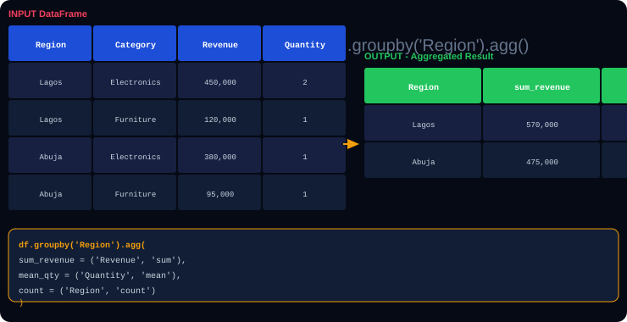
groupby() - Split, Apply, Combine
Line of Code
What It Does
df.groupby('region')
Groups the DataFrame by unique values in 'region'. Each group = all rows with the same region value.
.agg(new_name=('col','func'))
Named aggregation syntax. new_name is the output column name, col is the source column, func is the aggregation function.
'sum', 'mean', 'count'
Built-in aggregation functions. Others: 'min', 'max', 'std', 'median', 'nunique', 'first', 'last'.
'nunique'
Counts unique values in a group. Example: how many unique products per region.
.reset_index()
Converts the group keys (region) from index back to a regular column. Almost always needed after groupby.
.groupby(['a','b'])
Group by multiple columns. Returns a MultiIndex result. Use reset_index() to flatten.
groupby.py
groupby2.py
.transform('mean')
Computes group stats but keeps original DataFrame shape. Useful for adding a 'group mean' column.
# Named aggregation (best practice)
summary = df.groupby('region').agg(
total_revenue = ('revenue', 'sum'),
avg_price = ('price', 'mean'),
order_count = ('order_id','count'),
max_qty = ('quantity','max')
).reset_index()
# Multiple group keys
df.groupby(['region','category'])['revenue'].sum()
# Add a group mean column
df['region_avg'] = df.groupby('region')['revenue']
.transform('mean')
pivot_table()
Alternative to groupby. Creates a cross-tabulation matrix: pd.pivot_table(df, index='region', columns='category', values='revenue', aggfunc='sum').
Notes:
groupby() follows the Split-Apply-Combine pattern: split the data into groups, apply a function to each group, combine the results. The named aggregation syntax (agg with keyword arguments) was introduced in pandas 0.25 and is now the recommended approach. reset_index() is almost always needed after agg().

Slide 24
10
Merging and Joining DataFrames
Combine data from multiple sources.

Slide 25

pd.merge() - Combining DataFrames on a Key Column
Code / Parameter
What It Does
pd.merge(left, right)
Joins two DataFrames together. Returns a new DataFrame with columns from both.
on='key'
The column name to join on. Must exist in BOTH DataFrames.
left_on='a', right_on='b'
Use when the key column has different names in left and right DataFrames.
how='inner'
Keeps only rows where the key exists in BOTH tables. Missing rows are dropped.
how='left'
Keeps ALL rows from the left table. Right table rows with no match get NaN.
how='right'
Keeps ALL rows from the right table. Left table rows with no match get NaN.
merge.py
how='outer'
Keeps ALL rows from BOTH tables. Non-matching rows get NaN.
# Merge orders with customers
merged = pd.merge(
orders_df,
customers_df,
on='customer_id',
how='left'
)
# Stack monthly files
df = pd.concat([jan, feb, mar], ignore_index=True)
suffixes=('_x','_y')
When both tables have the same non-key column, suffixes distinguish them.
pd.concat([df1,df2])
Stack DataFrames vertically (add rows). All columns must match. Use ignore_index=True.
Notes:
merge() vs concat(). merge() joins on a KEY column - like SQL JOIN. concat() stacks DataFrames vertically - like SQL UNION ALL. Use merge() when combining tables with a shared ID column. Use concat() when combining multiple files of the same structure (January + February + March data).

Slide 26
11
apply(), map(), and applymap()
Apply custom functions row by row or cell by cell.

Slide 27
apply(), map(), and applymap() - Custom Transformations
apply_map.py
Code
What It Does
# map() - replace values in a Series
gender_map = {'M':'Male', 'F':'Female', '1':'Male', '0':'Female'}
df['gender'] = df['gender'].map(gender_map)
# apply() on a column with lambda
df['price_ngn'] = df['price'].apply(lambda x: x * 1580)
# apply() with a custom function
def classify_margin(margin):
if margin &gt;= 30: return 'High'
elif margin &gt;= 15: return 'Medium'
else: return 'Low'
df['margin_class'] = df['margin_pct'].apply(classify_margin)
# apply() across rows (axis=1)
def full_name(row):
return row['first_name'] + ' ' + row['last_name']
df['full_name'] = df.apply(full_name, axis=1)
# np.where() - fast if/else
df['status'] = np.where(df['sales'] &gt; 50000, 'High', 'Low')
# pd.cut() - bin continuous into categories
df['age_group'] = pd.cut(df['age'],
bins=[0,18,35,50,100],
labels=['Teen','Adult','Mid','Senior'])
series.map(dict)
Replaces values using a dictionary. Values not in the dict become NaN. Fastest for simple value replacement.
series.apply(func)
Applies a function to every value in a Series (column). Can use lambda or a named function.
df.apply(func, axis=1)
Applies a function to every ROW. axis=1 passes each row as a Series to the function.
lambda x: x * 1580
Anonymous function. x is each cell value. Returns the transformed value.
np.where(cond, a, b)
Vectorised if/else. Where cond is True, returns a. Where False, returns b. Much faster than apply.
pd.cut(col, bins, labels)
Bins a numeric column into labelled categories. bins=[0,18,35] creates [0-18] and [18-35] groups.
pd.qcut(col, q=4)
Cuts into EQUAL-SIZE quantile groups. q=4 creates quartiles. Unlike pd.cut which uses fixed ranges.
applymap(func)
Applies function to every CELL in a DataFrame (not just one column). Use for formatting or type checks.
Notes:
apply() vs map() vs np.where(). Rule: use map() for simple value replacement (dictionary lookup). Use np.where() for fast if/else conditions on a column. Use apply() only when you need complex logic that cannot be expressed as a vectorised operation. apply() with axis=1 is the slowest - avoid on large DataFrames.

Slide 28
12
Advanced Cleaning Techniques
Real-world patterns that go beyond the basics.

Slide 29
ADVANCED PANDAS CLEANING - pivot, melt, explode, and more
advanced.py
Technique
What It Does
# pivot_table - cross-tabulate
pivot = pd.pivot_table(
df,
index='region',
columns='category',
values='revenue',
aggfunc='sum',
fill_value=0
)
# melt - wide to long format
df_long = pd.melt(
df,
id_vars=['product'],
value_vars=['Q1','Q2','Q3','Q4'],
var_name='quarter',
value_name='revenue'
)
# explode - split list cells
df['tags'] = df['tags'].str.split(',')
df = df.explode('tags')
# str.extract with regex
df['year'] = df['code'].str.extract(r'(\d{4})')
pivot_table()
Creates a cross-tabulation. index= is the row grouping, columns= is the column grouping, aggfunc= is the calculation. fill_value=0 replaces NaN with 0.
melt()
Reshapes a WIDE table (many columns) into a LONG table (fewer columns, more rows). Opposite of pivot. Used to prepare data for Seaborn and Plotly.
id_vars=['product']
Columns to keep as identifiers. These stay as columns in the output.
value_vars=['Q1','Q2']
Columns to unpivot (melt) into rows. Each becomes a value in the var_name column.
explode('col')
When a cell contains a list, explode() creates one row per item. 'tags': ['python','pandas'] becomes two rows.
str.extract(regex)
Extracts the part of a string that matches a regex pattern. Returns a DataFrame.
pd.get_dummies(df['col'])
One-hot encoding. Converts a category column into multiple True/False (1/0) columns. Used before ML models.
df.pipe(func)
Chains custom cleaning functions. df.pipe(remove_nulls).pipe(fix_types).pipe(rename_cols).
Notes:
Advanced techniques. melt() is the most important of these - it converts wide format (one column per quarter) to long format (one row per quarter) which is what Seaborn, Plotly and most ML libraries expect. pivot_table() is the reverse. get_dummies() is essential before any machine learning - models cannot process text categories.

Slide 30
13
Final Validation and Export
Prove the data is clean. Assert it. Then export.

Slide 31
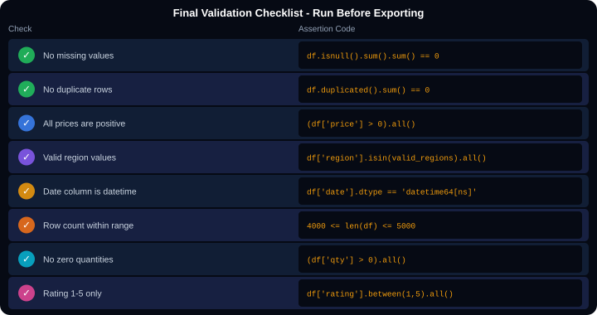
FINAL VALIDATION - Assert Before You Export
Code
What It Does
assert df.isnull().sum().sum()==0
Raises AssertionError if any NaN remains. Use this as a hard stop.
(df['price'] &gt; 0).all()
Returns True only if ALL prices are positive. .all() requires every value to be True.
df['region'].isin(valid)
Checks every region is in the allowed list. Chain with .all() for validation.
df['date'].dtype
Check the dtype is datetime64[ns], not object (string).
between(1, 5)
Returns True where value is between 1 and 5. Chain .all() to validate.
print(df.shape)
Print final shape so you can confirm expected row and column count.
validate.py
to_csv(index=False)
Exports to CSV. index=False prevents pandas adding a row number column.
# Full validation block
assert df.isnull().sum().sum() == 0, 'Nulls remain'
assert df.duplicated().sum() == 0, 'Dupes remain'
assert (df['price'] &gt; 0).all(), 'Negative prices'
assert df['date'].dtype == 'datetime64[ns]',
'Date is not datetime'
print(f'Clean dataset: {df.shape[0]:,} rows, {df.shape[1]} cols')
df.to_csv('nigeria_retail_clean.csv', index=False)
to_excel(index=False)
Exports to Excel .xlsx format. Requires openpyxl: pip install openpyxl.
export.py
df.to_csv('clean_data.csv', index=False) # export
df.to_excel('clean_data.xlsx', index=False) # Excel
Notes:
Validation assertions. assert is Python's built-in way to write automated checks that halt execution with an error message if the condition is not met. This is the professional equivalent of a QA checklist. Run these before handing data to stakeholders or feeding it into a model. If any assertion fails, go back and fix the issue.

Slide 32
PANDAS DATA CLEANING - QUICK REFERENCE CHEAT SHEET
Load
Missing - find
Missing - fill
Missing - drop
pd.read_csv()
df.copy()
df.info() df.describe()
df.isnull().sum()
(df.isnull().sum()/len(df)*100)
fillna(0) fillna(median)
fillna(method='ffill')
df.dropna()
df.dropna(subset=['col'])
Duplicates
Data types
String clean
Rename cols
df.duplicated().sum()
df.drop_duplicates()
df.dtypes
astype('int64') astype('float64')
pd.to_datetime(df['date'])
.str.strip() .str.lower()
.str.replace() .str.title()
df.rename(columns={'old':'new'})
df.columns.str.lower()
Filter rows
Outliers IQR
groupby agg
merge join
df[df['col'] &gt; 0]
df[df['col'].isin(list)]
df[df['col'].between(1,5)]
Q1=.quantile(0.25) Q3=.quantile(0.75)
IQR=Q3-Q1
df[(df &gt;= Q1-1.5*IQR) and (df &lt;= Q3+1.5*IQR)]
df.groupby('col').agg(
total=('col2','sum'),
avg=('col3','mean')
).reset_index()
pd.merge(df1,df2,on='key',how='left')
pd.concat([df1,df2],ignore_index=True)
apply map
Validate
series.map(dict)
series.apply(lambda x: ...)
np.where(cond, a, b)
assert df.isnull().sum().sum()==0
assert (df['col']&gt;0).all()
df.to_csv('out.csv',index=False)
Notes:
Cheat sheet. Print and distribute. The two-line rule: 1. Always work on a copy (df.copy()). 2. Always validate before exporting (assert statements). Everything else between is the 10-step cleaning pipeline in order.

Slide 33
🐼
Data Cleaning
with Pandas
Complete Teaching Deck
13 sections covered:
Load and Inspect
Missing Values
Duplicates
Data Types
String Cleaning
Rename / Reorder
You can now clean any real-world dataset using pandas.
Filtering Rows
Outlier Detection
groupby and agg
merge and join
apply and map
Advanced Techniques
Kajola Gbenga Adewale
Data Analytics Expert
Validation and Export
Next: Exploratory Data Analysis (EDA) - then Data Visualization with Matplotlib and Seaborn
Notes:
Closing slide. Students have covered the complete pandas cleaning toolkit - from loading raw data through the 10-step pipeline to final validation and export. The next session builds directly on this: EDA and visualization require clean data to produce accurate and meaningful charts.

